Slide 1
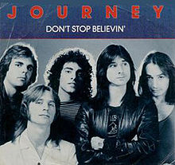
MY FAMILIAR-EXOTIC

Slide 2
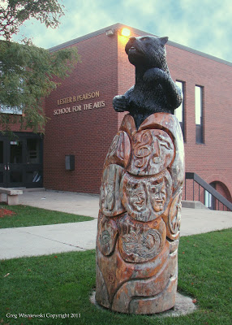
MY FAMILIAR:
Don’t Stop Believin by Journey

Slide 3
Don’t Stop Believin by Journey
VIDEO
https://www.youtube.com/watch?v=VcjzHMhBtf0

Slide 4
MY EXOTIC:
“Shemmame” by Ibrahim Tatlises
-I heard this song at my cousins wedding and had no clue what it was.
-Never heard it before, but after listening to it for the first time at the wedding I just had to understand it so that it could become familiar to me.
İbrahim Tatlıses is a Turkish folk singer and former actor of Kurdish/Arab origin.

Slide 5
UNDERSTANDING THE LYRICS
https://lyricstranslate.com/en/%C5%9Femmam%C3%AA-shemmame.html Shemmame
Shemmame bride
Daughter of uncle, bride
I'm a victim of yours shemmo
You're the divine light of the lights
You're snow and rain
Welcome, Shemmame
You're the bride of the brides
I love you so much
You didn't come, what do I do?
You say, cry boy
It's a shame, I'm embarrassed
Shemmame is bright blonde
Gazelle, don't go far away
You once kissed me
The boy's wounded

Slide 6
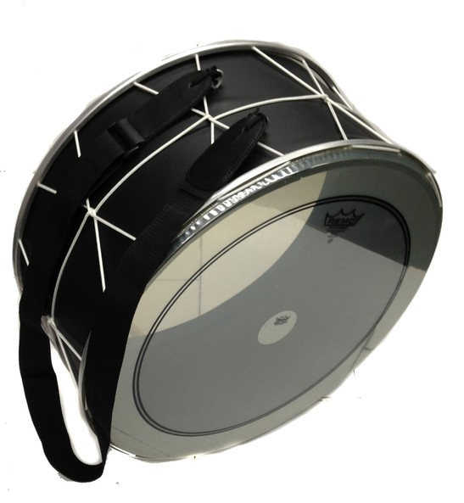
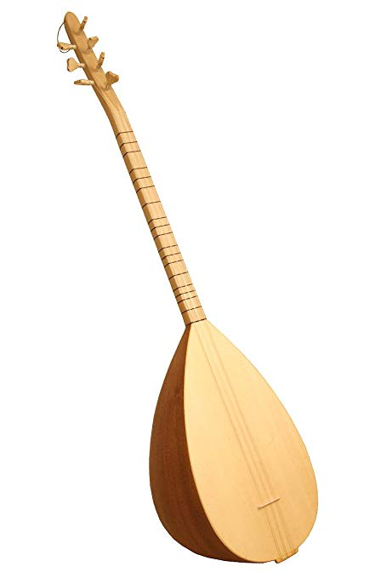
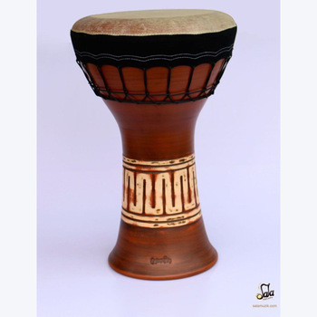
UNDERSTANDING THE INSTRUMENTATION
CHATZOZERAH
TUBEL
SAZ
DARBUKA
TAMBORINE

Slide 7
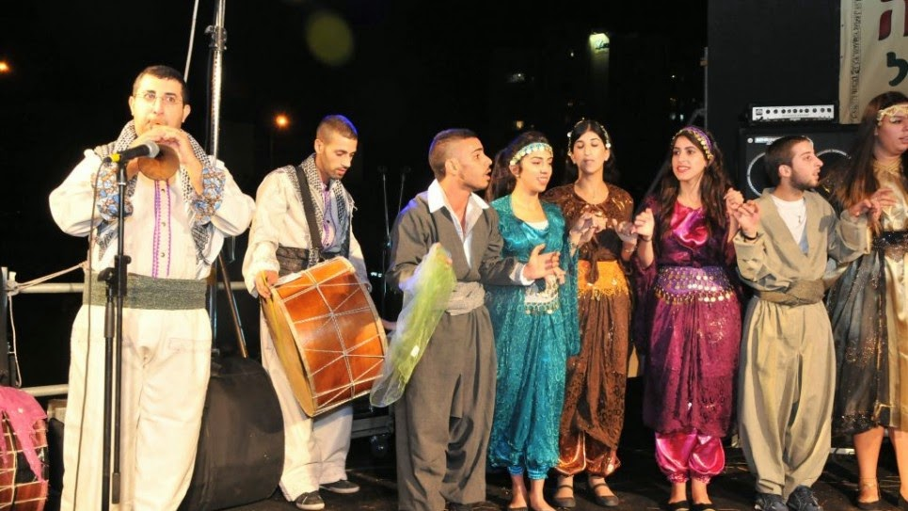
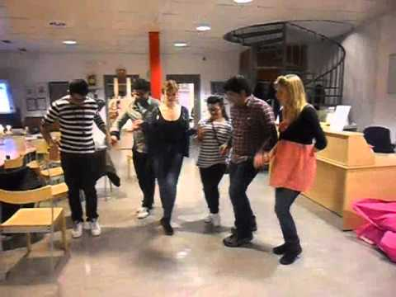
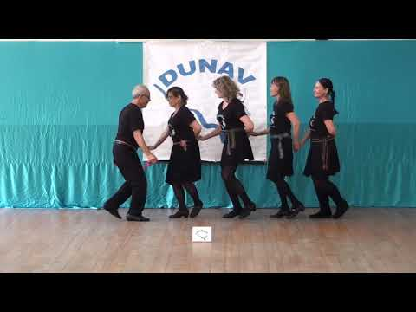
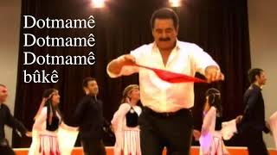
UNDERSTANDING THE DANCE
LINK TO MUSIC VIDEO:
https://www.youtube.com/watch?v=E_zUxFrJ_SE

